Slide 1

AVIA-GIT GROUP LLC
Freight Forwarding Company

Slide 2
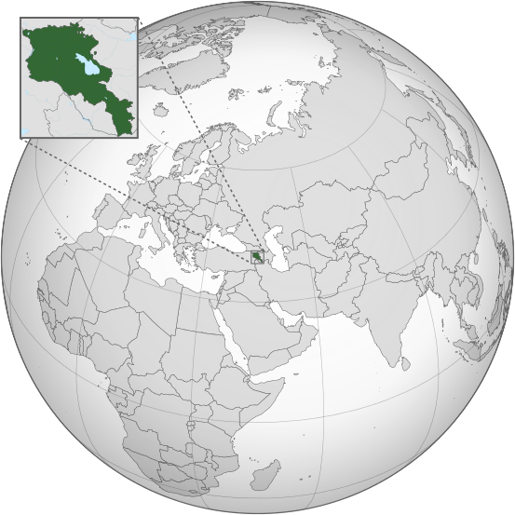


General Facts on Armenia
Official name: The Republic of Armenia
Area: 29 743 square kilometers
Population: 2 936 350 (2017 census)
Capital and largest city: Yerevan
Religion: Christianity (301 AD, Armenian Apostolic Church)
Government: Unitary Parliamentary Republic
Legislature: National Assembly
Currency: Dram (AMD)
Calling Code: +374

Slide 3

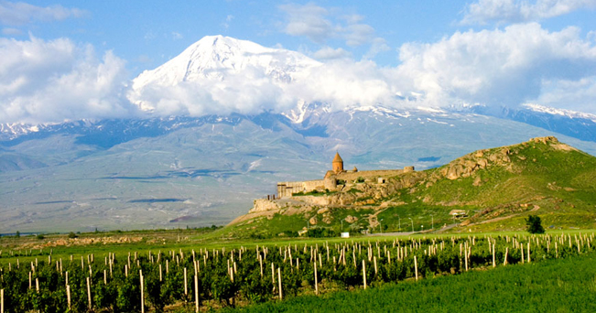
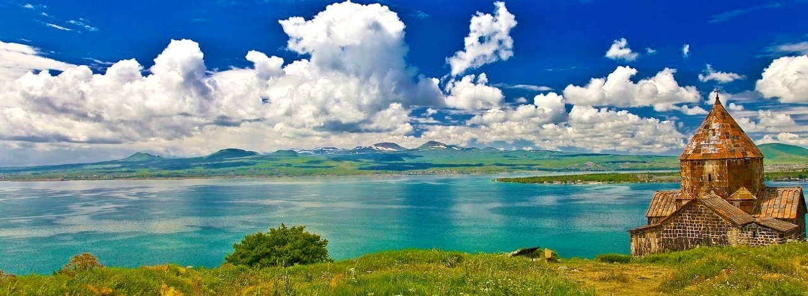
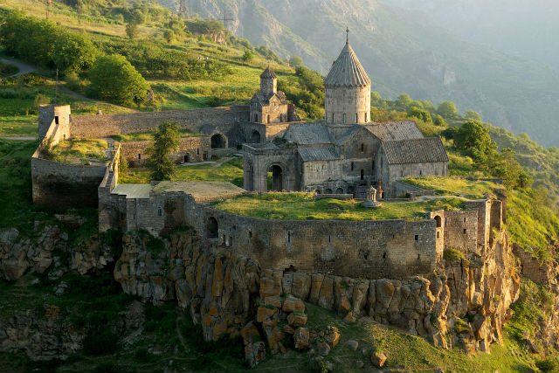
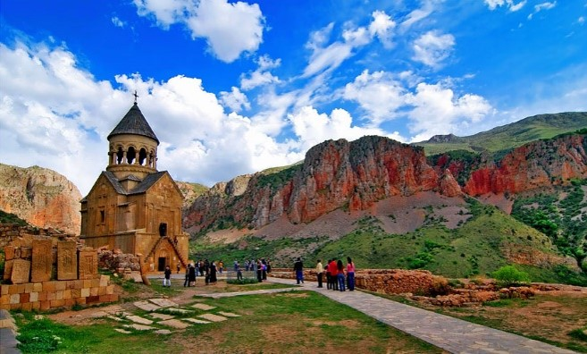

Slide 4

YEREVAN

Slide 5
Avia-Git Group LLC
Who we are
air and road freight forwarding and logistics company,
one of the leading freight forwarding companies in Armenia,
Avia-Git Group was established in 2000,
number of employees: 25
Our Address:
1 Zakian Str, Yerevan, 0010 Armenia
Tel:(+374 10)521546 (+374 10)587132
Fax:(+374 10)587129
Email: info@aviagit.am
Website: www.aviagit.am

Slide 6





Who we are
an IATA accredited freight forwarder since 2004.
a member of:
the official GCSA for S7 Airlines in Armenia
(code 60-3 7000)

Slide 7
Who we are
Our Mission:
Deliver quality service and personalized approach to our customers through sustainability and constant quality growth.
Our Vision:
To be the most trusted, safest and most innovative forwarder in the market.
Our Values:
Integrity: we are who we are,
Teamwork: we value each and every member of our team,
Passion: we love what we do,
Quality: what we do, we do it well,
Customers: we value our customers as business partners.
Innovation: we foster innovation and constant growth.

Slide 8
Three Keys To Success:
Teamwork
Competence
Innovation

Slide 9
What we do
We are one of the leading freight forwarders in Armenia, providing the following 5 main service types:
airfreight forwarding (all over the world)
road freight forwarding (EVN-TBS-EVN Multimodal transport)
logistics,
warehousing and packaging
customs clearance
and brokerage
aircraft briefing

Slide 10

International Airfreight Forwarding
We provide a wide range of freight forwarding services which include transportation of the following types of cargo from and to Armenia:
general cargo
dangerous cargo
valuable cargo
perishable goods, such as chilled/frozen fish,
live crawfish and amphibians,
live animals
agricultural products, food, etc.

Slide 11


Dangerous Goods
Avia-Git Group is a leading Armenian carrier of dangerous goods by air.
Supported by our team of certified Dangerous Goods specialists, we have an exemplary safety and compliance record.

Slide 12

Road Freight Forwarding
(TBS-EVN-TBS Multimodal Transport)
The project was launched in 2013 in cooperation with Cargolux and our Georgian partners to service the TBS-EVN-TBS route. To date, we provide regular road freight transfers from TBS to EVN twice a week, transporting Armenia-bound airfreight shipments through Georgia

Slide 13

Logistics
Avia-Git Group provides solutions to ensure the
entire supply chain of products and shipments:
cargo storage and warehousing,
trucking service on a door-to-door basis.

Slide 14

Warehousing
We offer a full range of warehousing services for all types of cargo: general, perishable, dangerous and valuable among others.
Packing Solutions
We provide a range of packing services. Our specialists will suggest the packaging solution that works best for you.

Slide 15


Customs Clearance
and Brokerage
We have 15 years of experience behind us in customs clearance and brokerage. Our staff regularly participate in qualification courses and certification programs.
Aircraft Briefing
Our specially trained and qualified personnel provide the following services:
cargo loading/offloading supervision
inspection and coordination of fuel storage and distribution procedures
provision of meteorological and navigational information to the aircraft crew

Slide 16
Figures and Data
The volume of the cargo transported within
the past 5 years:
Year | By Air (kg) |  | By Land (kg) | Total (kg)
 | Import | Export
2019 (JAN,FEB, MAR) | 31 451 | 719 785 | 49 570 | 800 806
2018 | 149 363 | 2 780 251 | 780 017 | 3 709 631
2017 | 141 465 | 2 016 266 | 844 001 | 3 001 732
2016 | 94 068 | 2 446 773 | 706 143 | 3 246 984
2015 | 34 213 | 2 108 536 | 606 325 | 2 749 074

Slide 17
The volumes of import and export both by air and
land for the past 5 years
Cargo shipped (kg)
(JAN, FEB, MAR)
Years

Slide 18

Overview
one of the leading freight forwarders in Armenia,
IATA accredited freight forwarder since 2004,
airfreight and road freight forwarding,
multimodal transport,
logistics, warehousing and customs clearance,
over 15 years of experience in the market,
innovation, teamwork and quality management
AVIA-GIT GROUP LLC
1 Zakian Str, Yerevan, 0010 Armenia
Tel:(+374 10)521546 (+374 10)587132
Fax:(+374 10)587129
Email: info@aviagit.am
Website: www.aviagit.am

