Slide 1


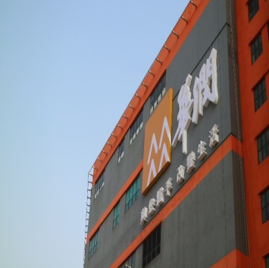
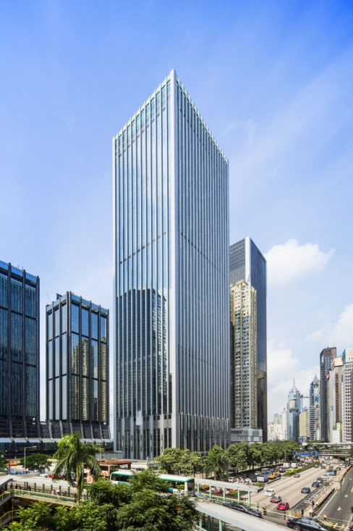

Farenco Freight Services Limited
-- Integrated Logistics Division of China Resources Logistics

Slide 2
CONTENT
01
02
03
04
05
Introduction
Facilities
Core Business
Customers
Contacts

Slide 3
01
Introduction

Slide 4

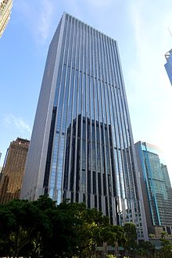
Parent Company
China Resources (Holdings) Co. Ltd. (hereinafter "CR”) is a multi-business holding enterprise group registered and operating in Hong Kong. Its predecessor was Liow & Company established in Hong Kong in 1938 and was renamed China Resources Company in 1948.
In 2020, CR realised a total turnover of USD 94.7 billion, a total profit of USD 10.4 billion and a total asset of USD 232.6 billion. As one of the Global 500 in the world, CR was ranked the 79th of the Global 500 by Fortune in 2020.

Slide 5
CRL & Farenco - History
2003
2016年
CRL is wholly-owned by China Resources Enterprise Limited (CRE) since 2003 .
China Resources International Logistics Center is officially in operation
Farenco Freight Services Ltd. (FFS) is the Integrated Logistics Division of CRL.
1948
2011年
China Resources Logistics (Groups) (CRL), whose predecessor Far East Enterprising Co.,(H.K.) Limited (FARENCO), was founded in HK in 1948.
China Resources International Logistics Center is completed.

Slide 6
02
Facilities

Slide 7
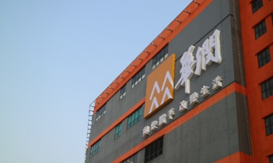
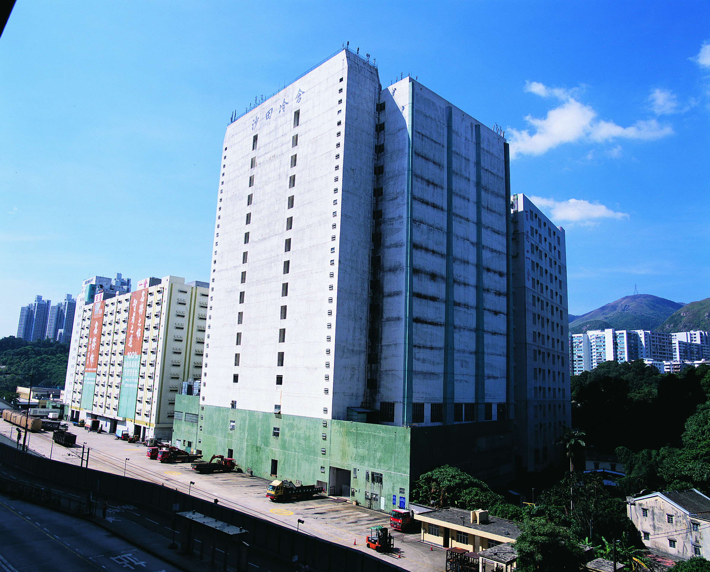
CRL - Facilities
Cold Storage Warehouse
More than 670,000 sq ft
Ranks 2nd in HK
Ambient Warehouse
HK：3,500,000 sq ft
Mainland：1,500,000 sq ft

Slide 8
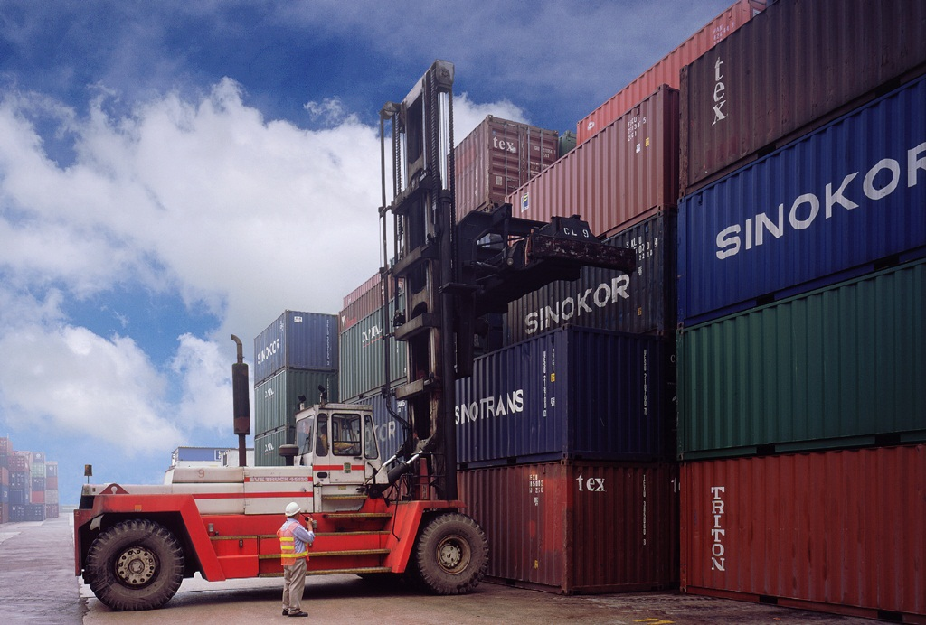
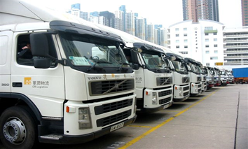
CRL - Facilities
Fleet
12 local and cross border tractors
A total capacity of 50+ trucks
Wharf
A 30,000 sq ft of container yard
Capacity of more than 3200TEU

Slide 9
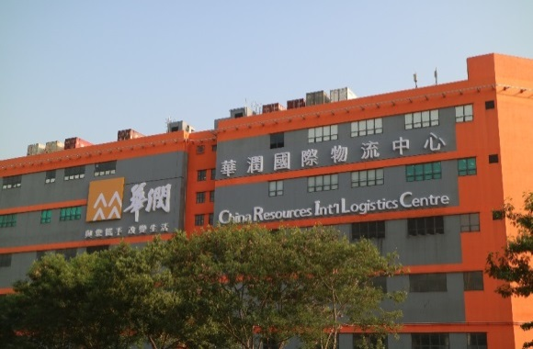
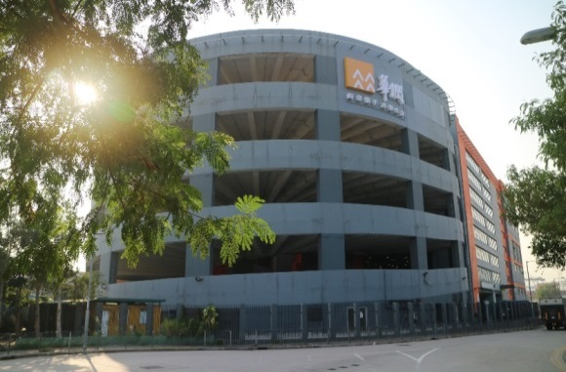
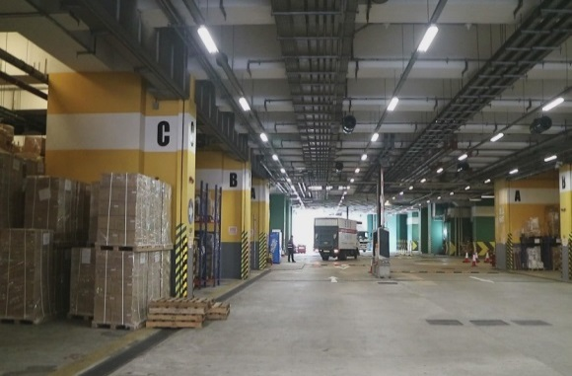

China Resources International Logistics Center
Started Operation In 2017
Best Location
Nearby Kwai Chung Terminal
More than 1 million Sq ft.
Abundant Loading Bays

Slide 10
03
Core Business

Slide 11
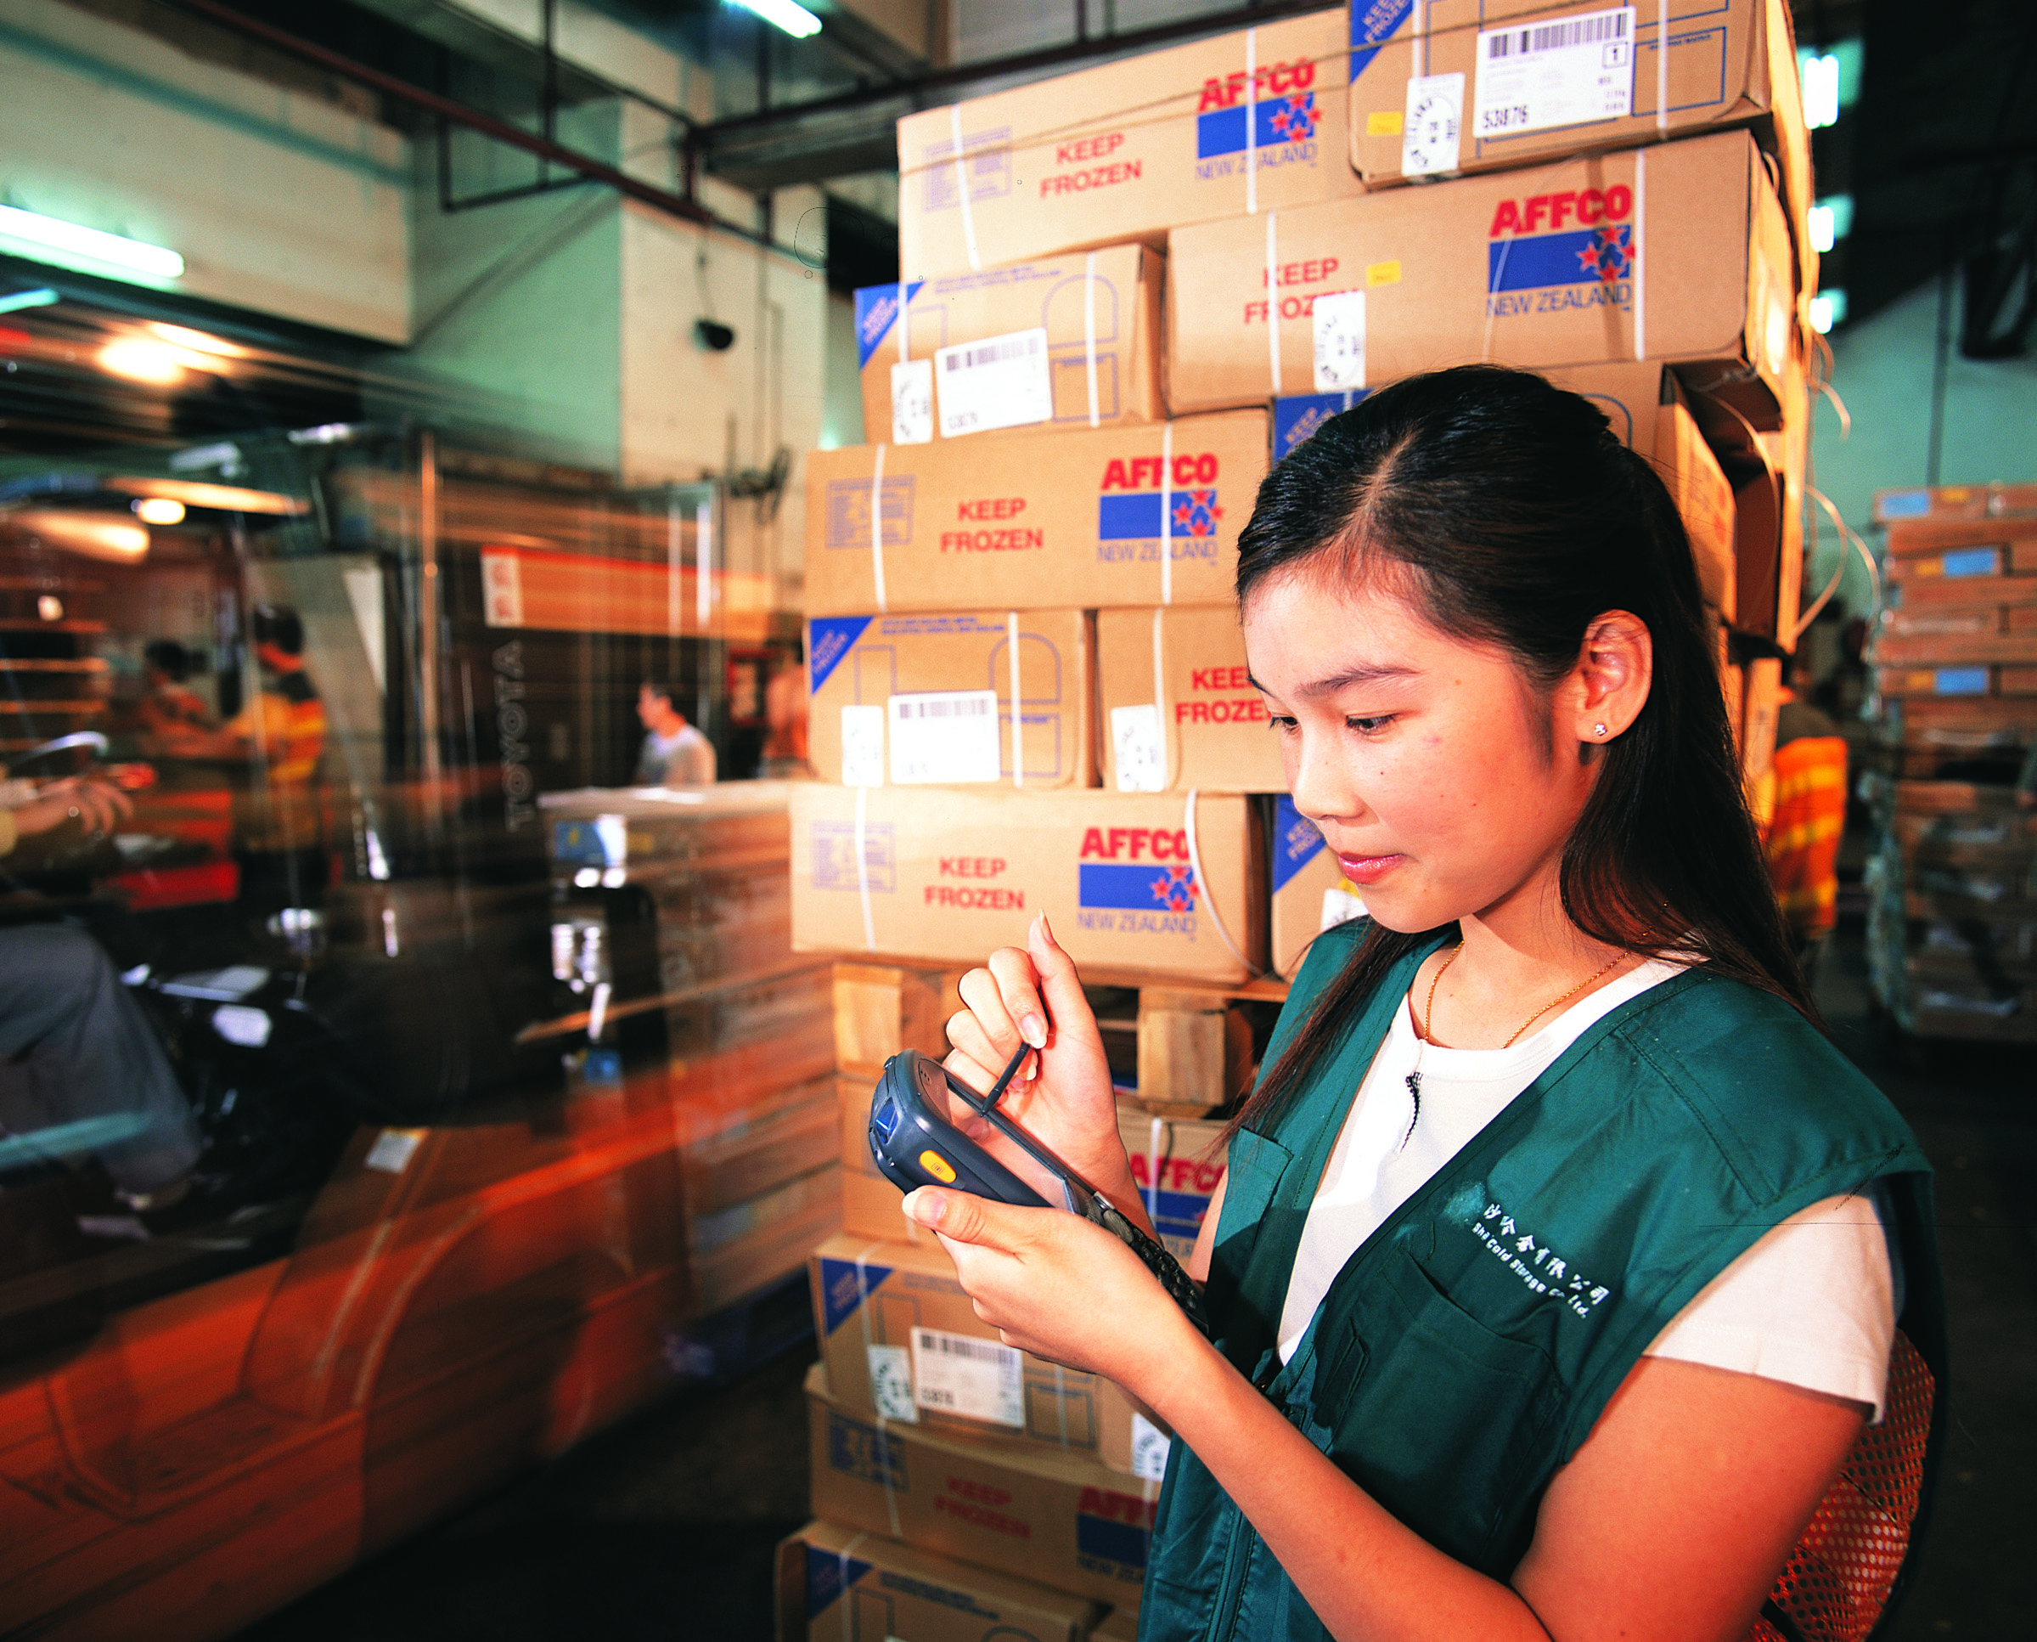

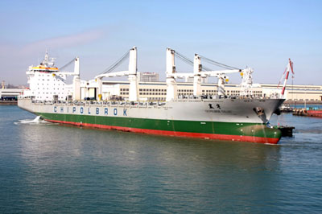
Farenco – Core Business
01
02
Farenco
03
High-quality, efficient and low-cost one-stop logistics services.
Third-party Logistics
Freight Forwarding
Ship Agency Service

Slide 12
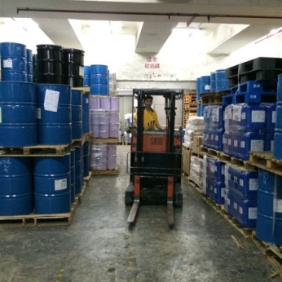
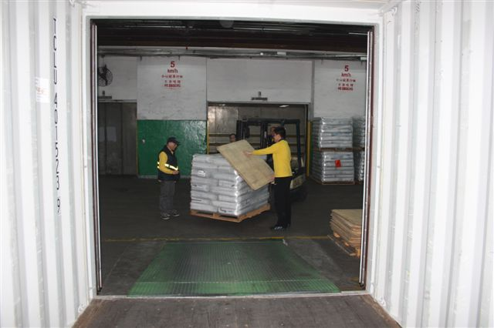
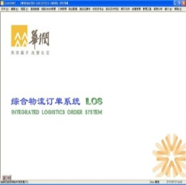
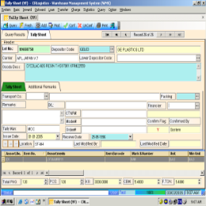
Farenco – Third Party Logistics
Our Services
01
04
Storage ,Haulage ,Delivery
Total Logistics Solution
02
03
Value added Services
Pick and Pack
Repackaging
Palletize/ De-palletize
Labeling
Shrink Wrapping
Documentation Storage
Tailor-made IT System
EDI exchange
Inventory checking
Order management
Cost analysis
Process monitoring

Slide 13
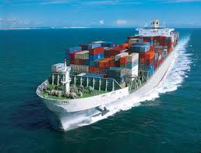
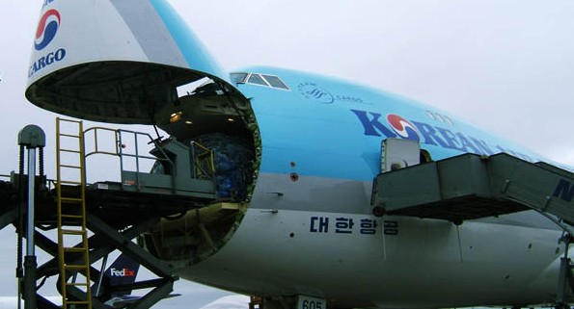
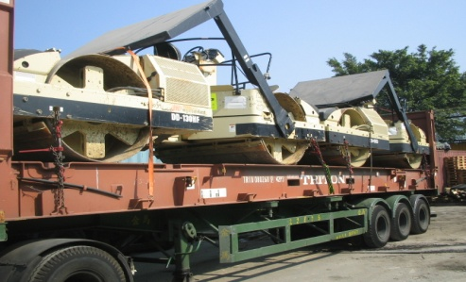
Farenco – Freight Forwarding
International
Transport
Other
Value-added
Services
One-stop intermodal road, sea and air transport
Door to Door
Warehousing, insurance, packaging and custom clearance services, etc.
Project Cargo
Major Market
Over-size & over-weight cargoes, such as machinery equipment that using break bulk service or special container.
Greater China region, Japan, Korea, South-east Asia

Slide 14
Farenco – Global Network
  Farenco has maintained good and stable relationships with agents in North America, Europe, Asia, Australia, etc. Most of them have been our partners for more than 10 years
  Farenco has developed agents and sister companies in the major ports in Chinese mainland, including Shenzhen, Guangzhou, Shanghai, Xiamen, Ningbo, etc.
  Farenco is a member of Security Cargo Network, which is one of world’s professional and reliable freight forwarding agents associations.
North America
Europe
Asia
South America
Australia

Slide 15
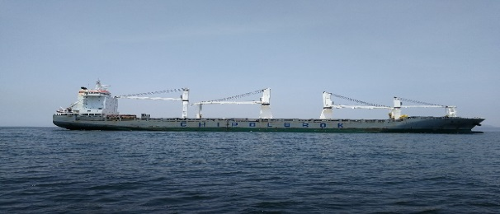
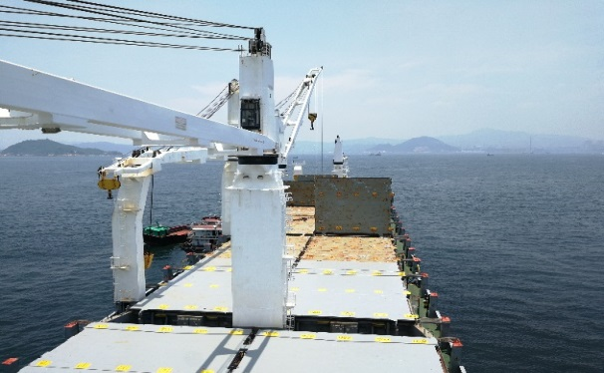

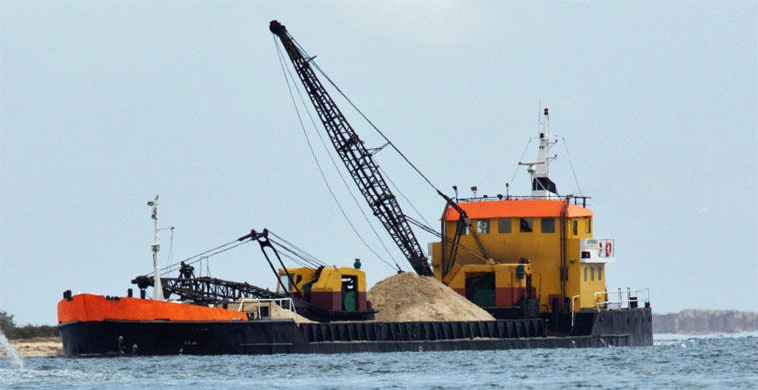
Farenco – Ship Agency Service
Declarations with Hong Kong Marine Department and Immigration Department for Arrivals and Departures of Vessels
Provide miscellaneous services: transport boat for crews, replenishment of food, water and fuel, etc..
Hong Kong ship agency of Chipolbrok
Hong Kong ship agency for Pearl River Trade vessels from/to Guangdong

Slide 16
04
Customers

Slide 17
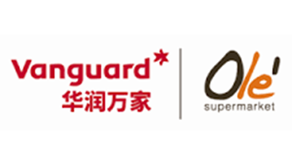




Farenco – Customers Reference
Our Customers

Slide 18
05
Contacts

Slide 19
Farenco – Contacts
Management Team
Ms. Amy Chan
Position: Assistant General Manager
TEL: 852-28283673
Email: amy.chan@crclogistics.com
Operation Team
Mr. Chan Kam Ho
Position: Manager, Freight Forwarding Department
TEL: 852-28283677
Email: kamho.chan@crclogistics.com
Mr. C. S. Li
Position: Assistant Manager, Freight Forwarding Department
TEL: 852- 28283481
Email: csli@crclogistics.com

Slide 20
Thanks!

