Slide 1








By George Karayannis
ROADFREIGHT DIVISION
presentation
Business Development Director
BSc Logistics
MSc International Business
14 years in the Industry
g.karayannis@phoenixglobalgroup.com

Slide 2
PHOENIX HISTORY
Founded in 1991
1994 ISO-9001
2017 Doing business with U.S. Government
2017 GDP – Good Distribution Practices
2005 ISO-14001
2010 Ethical business conduct certification
2014 Bulgaria Branch office
2016 Albania & Kosovo branches
2013 AEO certified
2013 North Macedonia Branch office
1996 IATA DG certified
2004 Cyprus Branch Office

Slide 3
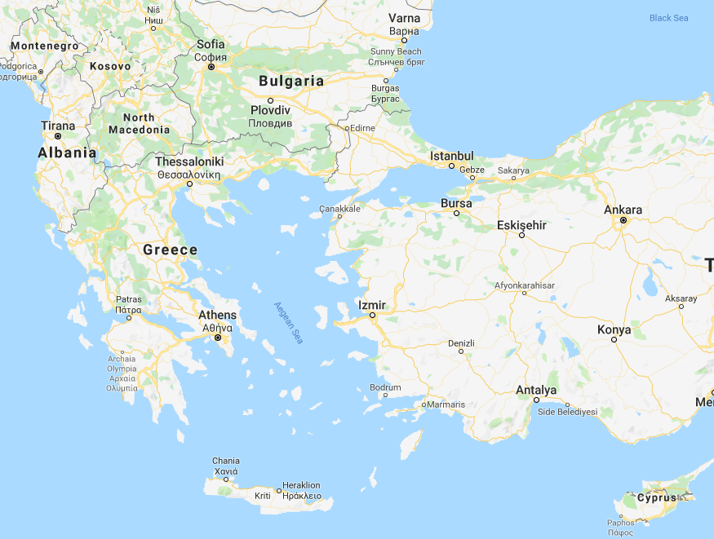
COVERAGE
HQ: PIRAEUS, GREECE
Branch offices:
GREECE
THESSALONIKI
ATH Airport
NORTH MACEDONIA
SKOPJE
KOSOVO
PRISTINA
ALBANIA
DURRES
BULGARIA
SOFIA
CYPRUS
LIMASSOL

Slide 4
PHOENIX ROADFREIGHT
ADVANTAGE
Core Service overview
PHOENIX subcontracts dedicated and flexible W/H near Antwerp
Weekly collections from Benelux, Northern France & West Germany &Weekly LTL console truck departures
Weekly departures from Hamburg
Weekly Departures every Thursday & Friday
Arrivals in Greece Tuesday and Wednesday
Weekend and Monday departures upon request

Slide 5
About PHOENIX Core Road service
Depending on cargo location no collection is required since operations can organize for international LTL truck to pick up directly
Extremely competitive rates as this service is ongoing since 1991, combined with great quality and intellectual capital over the years.
LTL and FTL competitive advantage
Weekly temp controlled truck with dual temp compartments
ADR capabilities

Slide 6
Core service explained…
PHOENIX is GDP certified and moves PHARMA cargo with dual temp trucks
PHOENIX is ISO:14001 and moves Chemicals (also in drums) ADR
PHOENIX moves High valued goods (especially from Hamburg)
PHOENIX uses EU trucks and Drivers to assure quality standards
PHOENIX uses routing via Italy to Greece for cargo security and reliability

Slide 7
Rest of Europe
PHOENIX carries its knowledge for the rest of the European region providing a competitive service on an AD-HOC basis
Capability to secure rate and truck service availability in order to set up more regular routings in other areas (as previously done with Paris FR, Mikulov CZ & London GB)
Road transport between Greece to and from the Balkans is a daily standard

Slide 8
Commodity & Industry strengths
Time Critical
Perishables & reefer
PHARMA
CHEMICALS
ADR
Exhibitions
High Value goods
Own fleet of ISO tank containers for inta European sea traffic

Slide 9
Conclusion
PHOENIX is an expert in setting up and maintaining trade lanes
Very strong Core market
Cooperation opportunities based on PHOENIX service
Cooperation opportunities in using added value services and external expertise

