Slide 1
Connecting India to the World………

Slide 2
The Land of Opportunities…
46% increase in FDI

Slide 3
Who are we :
9 Strategically located offices
116 Employees
32 Sales People
3 New Offices in 2019

Slide 4
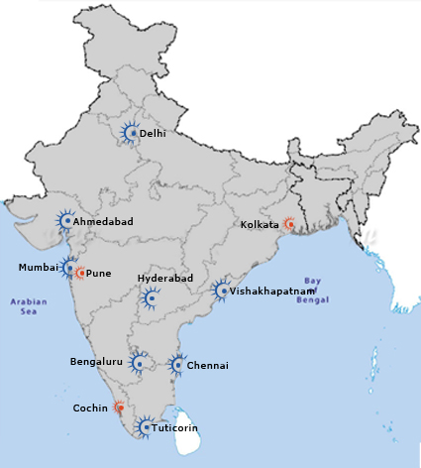
Our Foot Print :
Current offices
Future offices
Bangalore
Chennai
Delhi
Mumbai
Hyderabad
Ahmedabad
Visakhapatnam
Tuticorin
Coimbatore
Pune
Cochin
Kolkata

Slide 5
Our Services
Air Services
Ocean Services
Customs Brokerage
Warehousing & Distribution
Project Logistics-Bulk, RoRo & Chartering
Cargo Insurance
Last – Mile Deliveries
DG Cargo

Slide 6
What we do :
Air Import Consolidations from major gateways in US ,Europe & Asia .
Hard Block Space Agreements
Very Aggressive Pricing from/to US & Europe
Buyer Consolidation
PO Management
Customs & Compliance
Strategic Partnership

Slide 7
Our DNA : Sales
Momentum
Create Competition
Awards & Rewards
Sales Training
Tandem Sales

Slide 8



Industry Focus:
Automotive
Pharmaceuticals
Aerospace.
Engineering
Electronics
Hi-Fashion Apparel /Leather

Slide 9
Email : Arun.Sharma@freyerinternational.com
www.freyerinternational.com

