Slide 2
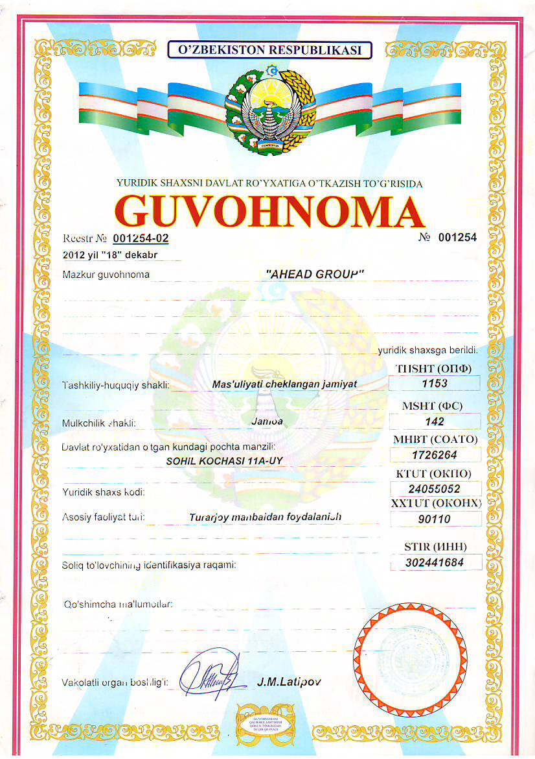
Company incorporation
Was founded by two friends, Mr. Dilmurod Rakhimov and Mr. Nodirkhan Salihov, both with the solid background in customs brokerage company.
Driven by entrepreneurship spirit to own an own logistic company. // That is the reason we work hard.
Officially incorporated in December 18 2012.
Initially we were positioned as a customs broker.

Slide 3
Management
Mr. Nodrikhan Salihov is the chief managing director, with the more than 10 years of experience, has profound knowledge of customs law. Responsible for overall management, customs clearance.
Background MSc, BSc.
Mr. Dilmurod Rakhimov is the Logistics Manager, responsible for development of International Logistics and International Affairs of the company.
Background MBA, BA

Slide 4
Mission & Objectives
Logistics is a complex process, we ought to make it simple for our customers.
To grow from a single link in Logistics chain to full scale Global Logistics company.

Slide 5
Core Business
We are very strong in Uzbekistan Customs Consultancy (Imp&Exp) and Customs Brokerage Services.
We are confident with profound knowledge and experience in this field.
On average 11 experienced specialist are engaged with customs clearance of goods of our customers daily.
We offer all type of Imp&Exp customs clearance services including full “deliver to door” services.
Customs Brokerage is our main revenue generating field.

Slide 6
What we adhere
Customer oriented services and fulfilling the obligations with anyone is the main code of our conduct. We believe that trust is must!
Adhering to this code have made us successful even during recession of 2014-2017 following US imposition of sanctions over Russian Federation, the main trade partner of Uzbekistan, followed by depreciation of local currency for more than 250%, just to prove that trust is the most valuable asset and customer oriented services is the best strategy in the long term.

Slide 7
Trade Recession and Company Growth

Slide 8
Our subsidiary companies
Trade company “Unipay Trading” LLC – Main activity International trading, also offers consignee services.
Accounting and Income taxation consultancy company “MarSys” LLC – offers consulting services in Accounting and Income taxation, Accounting outsourcing.
Main customers are foreign companies in Uzbekistan.

Slide 9
International Forwarding and New Challenges
From the beginning of 2018 we started offering international forwarding services to our customers.
At the present time we have steadily growing orders for inbound forwarding services mainly from PRC and South Asian countries.
We are looking for other destinations as well, main destinations for us are CIS countries, Europe, Middle East Countries, India, Pakistan, East and South Asian countries.

Slide 10
What we can offer for SCN members and our International partners?
Consultancy services on – Taxation, Customs Law!
Customs clearance. Including delivering “to door”
Warehousing.
Consignee services.
Local and International forwarding

