Slide 1
KIY AVIA CARGO Ltd
Fast, safe and exact cargo delivery
25 years of experience

Slide 2
UKRAINE: the center of Europe
Ukraine is the second-largest country by area in Europe.
It is a transit country that became a “bridge“ between Europe and CIS countries.
Geographical location gives us an opportunity to organize transit via Ukrainian sea ports of Odessa and Illichevsk to Russia, Moldova, Belarus, Caucasus (Georgia, Armenia, Azerbaijan) and other CIS countries.

Slide 3
ABOUT US
KIY AVIA CARGO Ltd. is Ukrainian freight forwarding Company established in 2002.
KIY AVIA CARGO Ltd. is a part of major Ukrainian concern KIY AVIA, leader in sales of passenger operation and tourism services.
Operational staff numbers 24 highly educated and certified logistic managers, licensed customs brokers, professional packers and drivers.
KIY AVIA CARGO is represented in main transport hubs and industrial centers of Ukraine
The principles of corporate culture of the company are activity, effectiveness and personal responsibility.

Slide 4
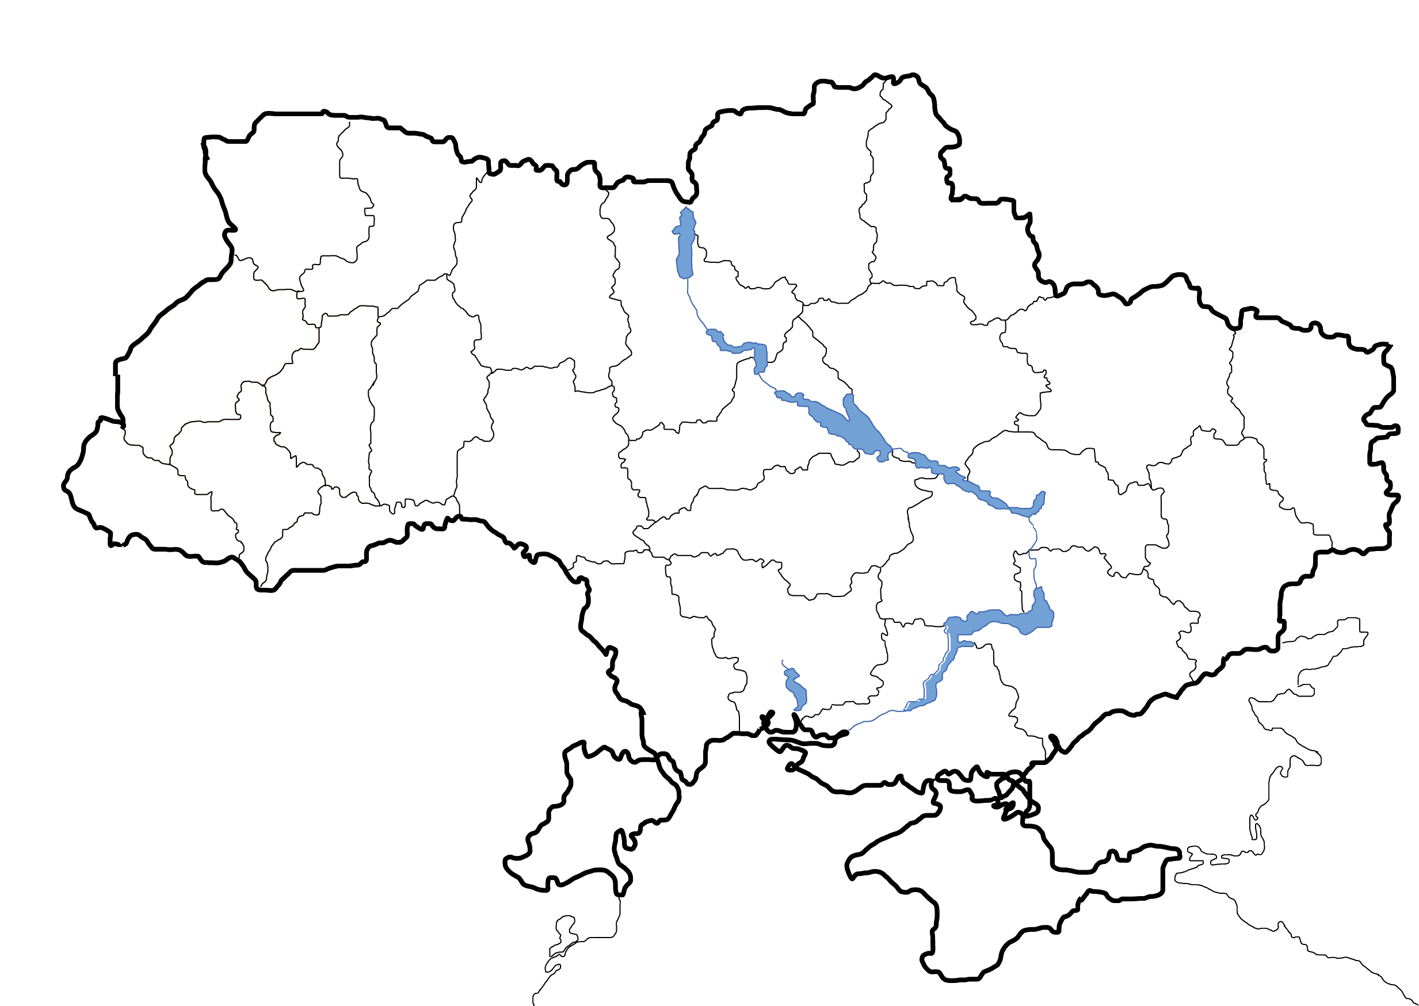
NETWORK
Kyiv
head office
Boryspil
main air hub
Kharkiv
Cherkasy
Dnipro
Odesa
main sea hub

Slide 5
NO ORDINARY SERVICES
Air, sea, ground freight
Moving services
Customs brokerage
Packing
Warehousing
Fair logistics
Transportation of dangerous goods, perishables, animals, etc.

Slide 6
WHY TO CHOOSE US
shipment of
any difficulty
Competitive pricing
Client support 24/7
Experienced staff
Door-to- door service
Insurance solutions
Individual approach

Slide 7
ADDITIONAL PROTECTION
CARGO INSURANCE
Freight insurance is the right thing if you want to manage your shipping risks
Protection against all risks of physical loss or damage to freight from any external cause
High-quality insurance coverage at a competitive price
Fast reimbursements

Slide 8
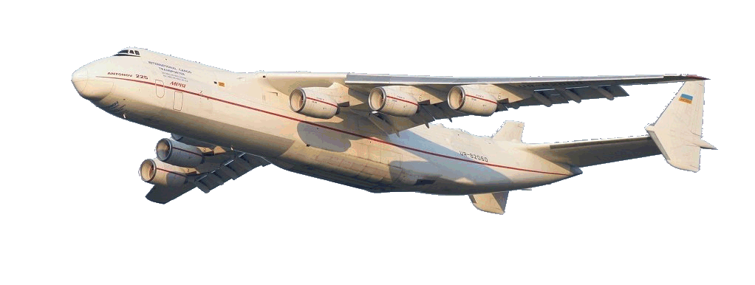
OUR successful CLIENTS

Slide 9
AND…
We work not only with companies but also with individuals.
We move personal effects and diplomatic cargo.
Our team is highly skilled and familiar with such specific shipments as:
- piano - art objects - antique items
-motorcycle, car and any other vehicle.
Among our clients are diplomats, members of foreign embassies and famous artists.

Slide 10
www.kiyavia.eu
www.cargo-ukraine.com
HEAD OFFICE
Zlatoustivska st. 2/4, of. 20, Кyiv, Ukraine
Tel.: +380 (44) 490-49-12
Tel.: +380 (44) 351-64-68, 499-62-28
Mob.: +380 50 367-97-07
Info.cargo@kiyavia.com
Managing director
Konstantin Grinko
Grinko@kiyavia.com
mob: +380 67 509-81-58
Sea freight department:
Kiev: cargo@kiyavia.com Odessa: odscargo@kiyavia.com
Air freight department:
export: cargo.avia@kiyavia.com
import: forwarder@kiyavia.com
Trucking department:
auto@kiyavia.com

