Slide 1



Slide 2
ABOUT
Milla Group of Companies is a Customs Brokerage, International Transport and Logistics service provider. By air, sea and land from all over the world; provides global services to the world in a fast, accurate, efficient and economical way.
Milla Group of Companies offers solutions by providing services in line with the needs of its customers as Bonded Warehouse, Free Warehouse and E-Trade Warehouse, as well as Customs Clearance and Transportation operations.
Milla Group of Companies maintains the worldwide scope of the reputation we have built over the past decade for pricing, service and operations.
Milla Group of Companies always provides the best service to its customers and overseas partners with the right procedures; responds to changing needs and demands in the fastest way.

Slide 3

OUR MISSION
Thanks to our knowledge and experience, we get strength from our customers we can reach in the sector, and we want to add strength to our customers, whom we get our strength from.

Slide 4
OUR VISION
To achieve success in the world that we have achieved in our developing country.

Slide 5
TARGETS and PRINCIPLES
To determine the needs of our customers and to provide service without compromising our quality and sustainability principles.
To be behind our word at all stages from the formation of the service request to the fulfillment of the requests and to always stand by our customers.
Our indispensable principles are cooperation based on transparent, honest, sharing and open communication with our customers, business partners and employees we serve in our activities, the society we are involved in and all legal authorities.

Slide 6



CUSTOMS CLEARANCE
Milla Customs Consultancy, with its managers with 20 years or more of industry experience, as well as its young and dynamic team, is an institution that blends experience and dynamism in the sector and has adopted the principle of providing boutique service.
With its technological infrastructure that can use the EDI system, which can be connected online to all customs administrations within the borders of the Republic of Turkey, all transactions can be tracked electronically over the system.
With its offices located in Istanbul customs and experienced field personnel, transactions are concluded as quickly as possible.
Customs and Foreign Trade legislation is followed on daily basis and your company is informed about the changes published as sectors in an understandable and summary form. In addition, these changes are published on our website on daily basis, allowing you to access all foreign trade and customs changes from a single source.
The services of obtaining import and export permits, making applications through TAREKS and Single Window System, approval of Chamber of Commerce and consulate in export transactions are carried out by our company.

Slide 7

ROADFREIGHT
Milla International Logistics provides import and export road transport services in all Europe, Middle East and CIS regions, especially Germany, Netherlands, Belgium, Italy, Spain and England, with its wide service network and strong agencies around the world.
It provides transparent, quality and reliable service with its operational and sectoral expertise, customer-oriented solutions, a team that truly adopts customer relations management, order management systems, and forwarding skills.
Complete / Partial regular trips to every region that can be transported by road,
Fast, reliable and economical service,
Transports that require special equipment (Mega, Double Deck, Refrigerated, Suspended and Lifted Vehicle),
Door-to-door delivery,
Speedy, Minivan transport services, with Express goods collection and distribution,
Direct follow-up with the customer at every stage of the shipment, fast and accurate information,
Daily automatic location information.

Slide 8
SEAFREIGHT
Milla International Logistics provides full (FCL) and partial (LCL) container transportation services to and from all ports in the world with its agency network spread over 199 countries in maritime transport, where most of the world trade takes place.
Our Sea Freight Services
Full (FCL) / partial (LCL) sea transportation from all ports of the world,
Transit container transportation,
Thanks to the contracts made with sea lines and shipowners, convenient freights,
Optimal service with different ship owner / line options,
Competitive prices for import shipments from the Far East,
Special equipment transports (Open Top, Flat Rack, Reefer, High Cube and Tank Container),
Continuous information flow from the purchase to the delivery of the goods.
follow-up, timely and accurate information,

Slide 9
AIRFREIGHT
Milla International Logistics, with its global agency network and established locations, and its experienced and dynamic team, offers different solutions to deliver products to all airports in the world.
Our Air Freight Services
Door-to-door airline transportations from all world airports,
Service diversity with different airline alternatives,
Competitive price alternatives with consolidated shipments,
Combined and Cross Transport,
Storage, handling, distribution, customs clearance, palletization, integrated with air transportation in line with customer needs,
Continuous follow-up and timely and accurate information from the purchase to the delivery of the goods with fast information flow

Slide 10
RAILWAY TRANSPORTATION
Milla International Logistics provides its customers with a cost advantage, fast and safe service with mutual flights to Germany, Austria, Czech Republic, Slovakia, Poland, Hungary and many other European countries in railway transportation, which is among the most important advantages of cost advantage and environmental friendliness. provides transportation service.
Our Rail Freight Services
Environmentally friendly and regular service with fixed times,
Minimum damage rate,
With 45 HC containers, the possibility of loading in the same cubic meters as the road and loading more tonnage than the road,
Fast, reliable and economical service.

Slide 11
DOMESTIC TRANSPORT
With our daily distribution network in Istanbul, we carry out the fast, reliable and economical transportation of your products from every point of the city.
Complete / partial transportation,
Door-to-door delivery.
Container transport
Hanging textile transport
Dangerous product shipments
Refrigerated or heated transport

Slide 12
WAREHOUSING
With the Effective Warehouse Management System of Milla International Logistics, all transactions occurring in the inventory, from the storage process that starts with the receipt of the product to the receipt of orders in warehouses and distribution centers, are monitored. With its technological infrastructure and solution-oriented experienced staff, it provides warehouse services in bonded warehouses allocated for products brought from abroad, together with its business partners on the European and Anatolian side, within the framework of the relevant legal legislation.
Our Storage and Logistics Services;
Collection and Packaging Services
Integration with Supply Chain Partner Systems
Goods Acceptance, Order Preparation, Waybill and Invoicing Services
LOT, FIFO, LIFO, Serial Number Based Inventory Control
Raw Material and Semi-Product Supply for Production Warehouse Services;
Global handling permit
Transit operations
Product acceptance/shipment with hand terminal

Slide 13
INSURANCE
Milla Group of Companies carries out insurance transactions in line with the demands of its customers in order to provide better service to its customers and to minimize the risks in logistics organizations.
We strongly recommend insurance for our customers to be safe against damage and material losses that may occur in international transportation.

Slide 14

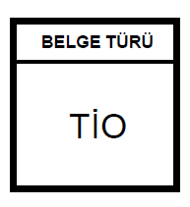

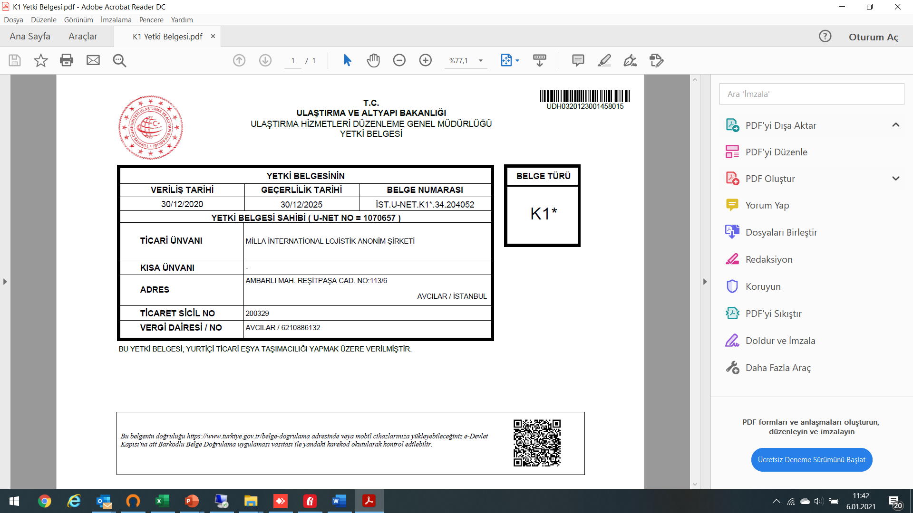



OUR CERTIFICATES

