Slide 1


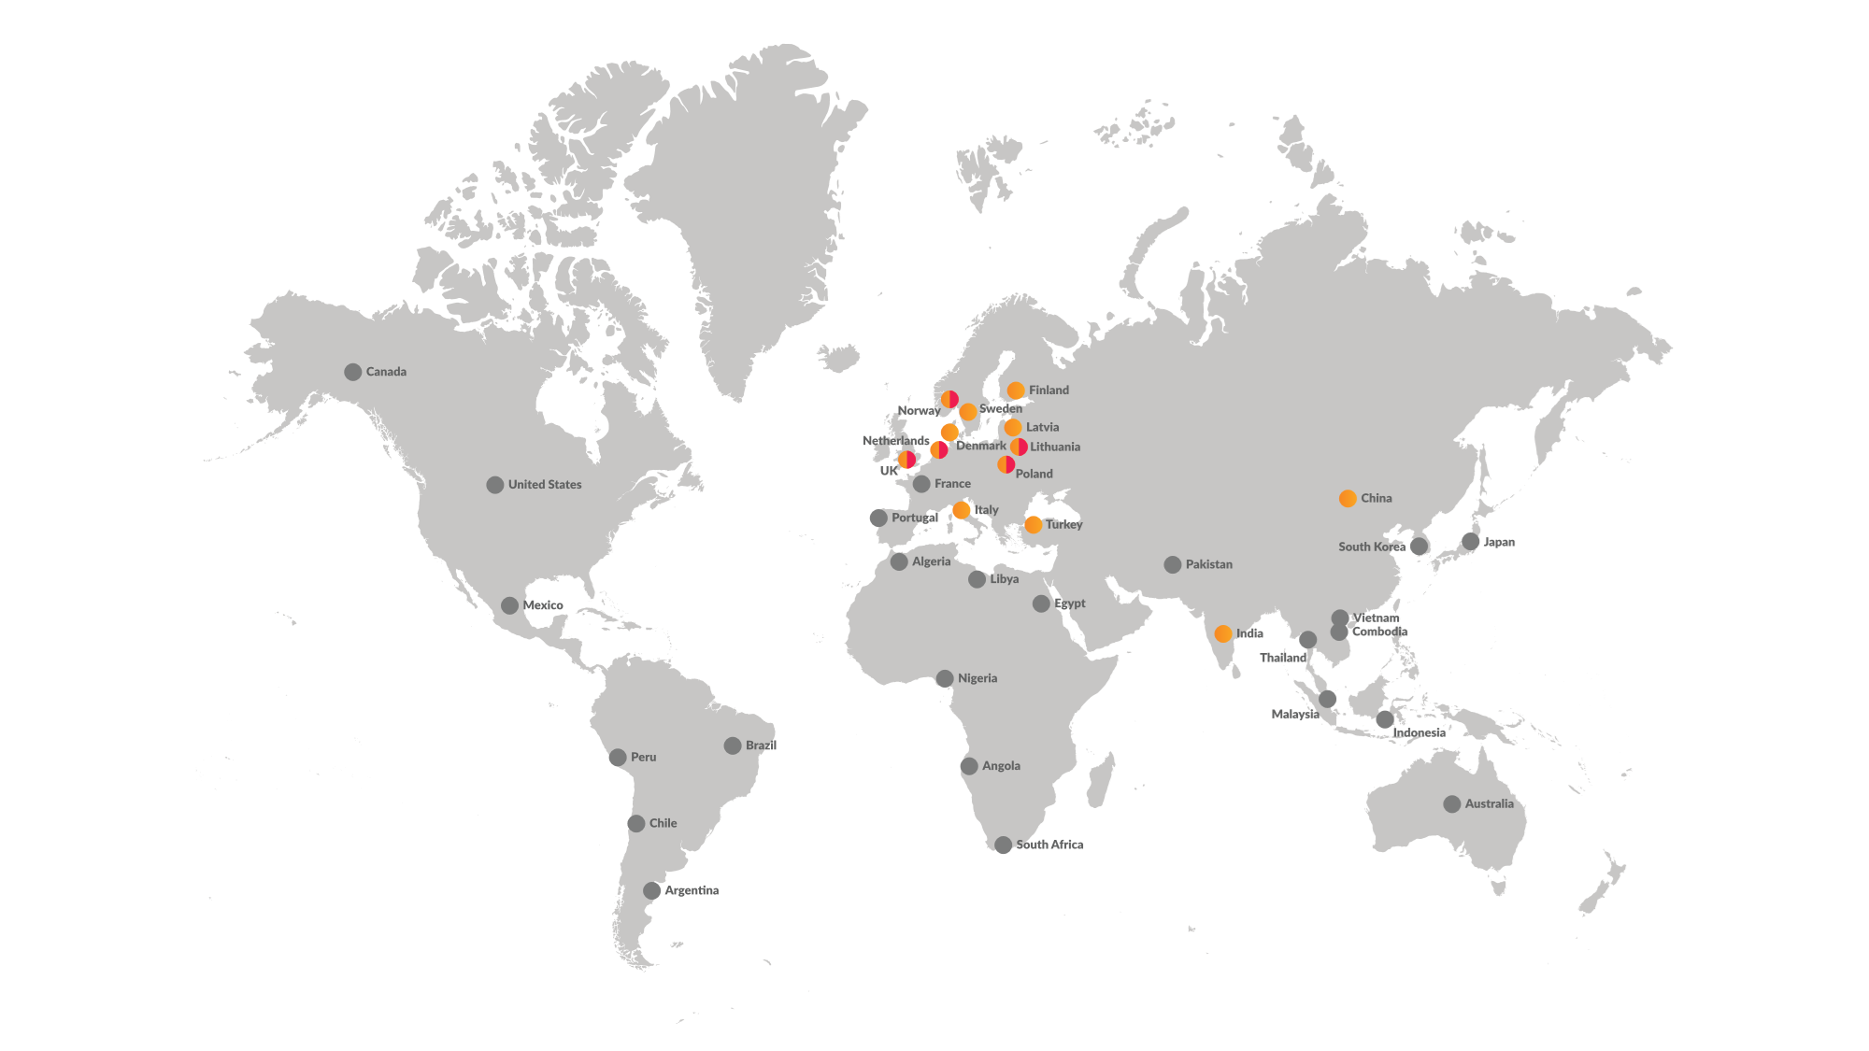
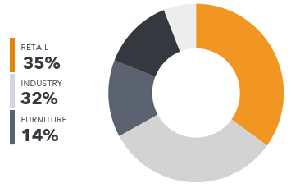
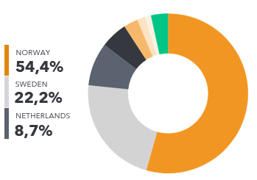
Sweden
13
Countries
Gothenburg – HQ
Jönköping
Sundsvall
Östersund
Turnover 80 MEUR
80 Employees
30
Offices
680
Employees
Ocean Freight, Short sea own SS-line, Airfreight, Customs Formalities, Events, Exhibition, Cross trade shipments.
Roadfreight, Domestic and Nordic distribution, warehouse for pick and pack – E-commerce.
General goods, retail, machinery, Dangerous goods, consols.
China/India, Asia, USA/Canada, Europe, LATAM
E-care portal –tracking, documents
35%
Retail Industry
Turnover group 3,7 BNOK
Countries
Industries
Control Tower
Cross docking
Vendor Management
3PL Warehousing
Logistics for Online Shops

