Slide 1

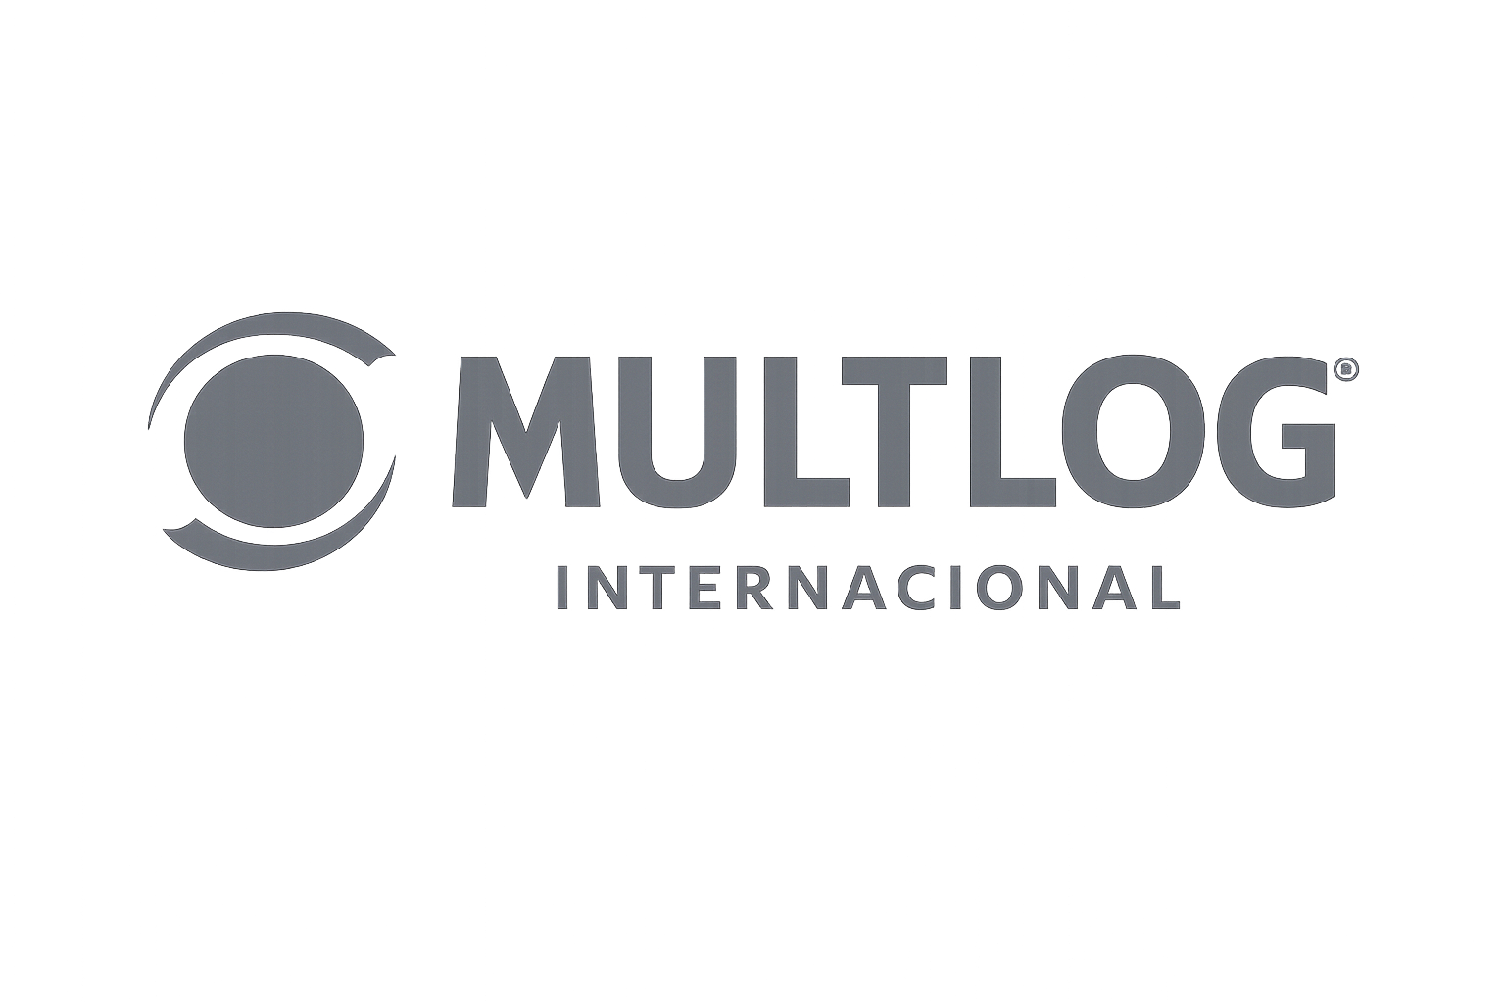
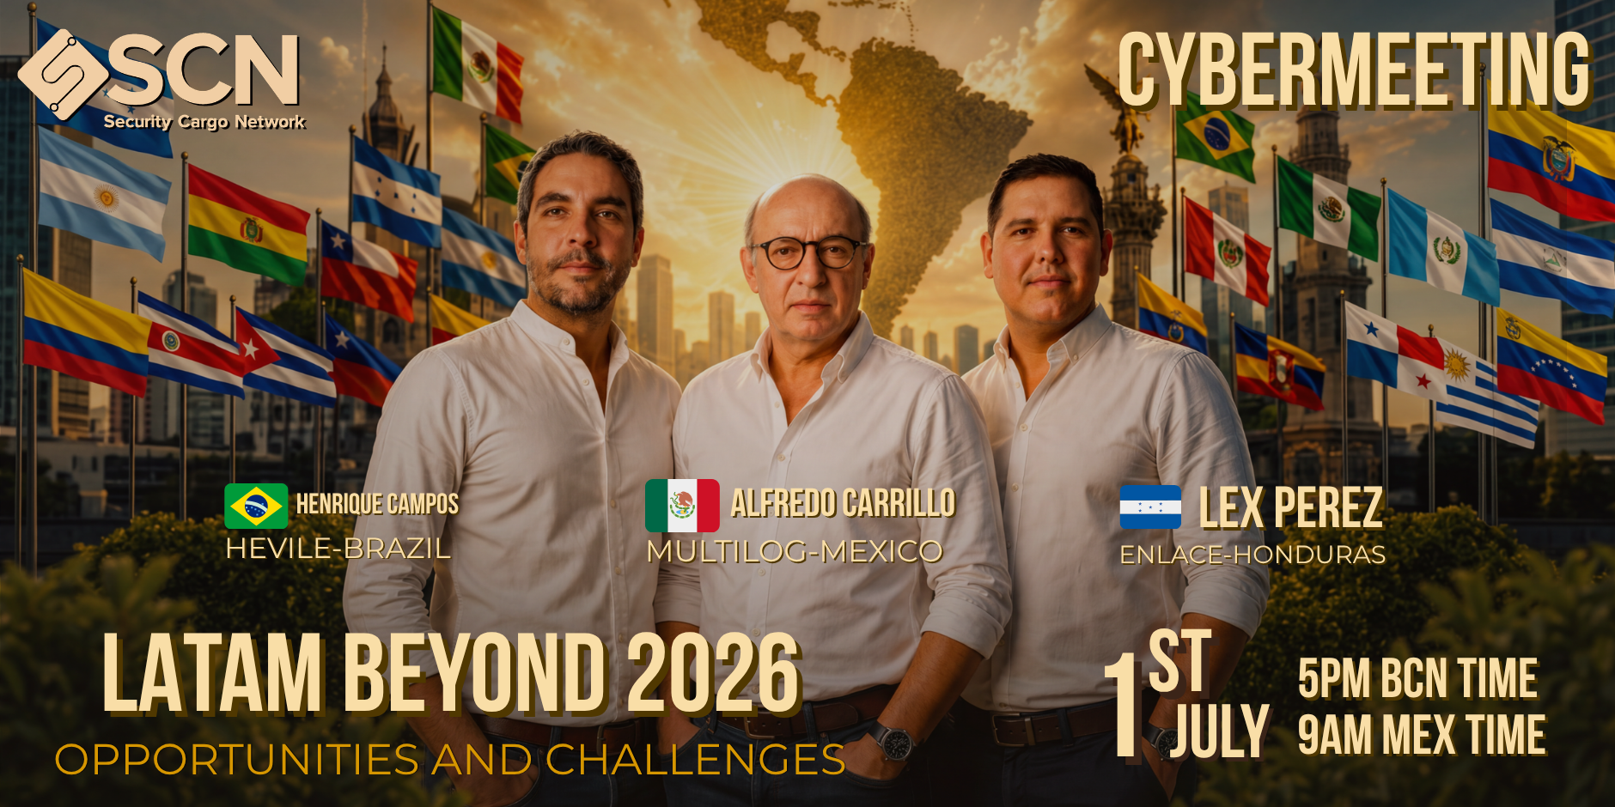


Slide 2
LOGISTICS IN LATAM
Opportunities & Challenges 2026
Strategic perspectives for independent freight agencies in the SCN network
2.2%
$40.9B
240
LATAM GDP Growth
2026 (ECLAC)
FDI in Mexico
(last period)
SCN Companies
in 138 countries
Security Cargo Network | 2026

Slide 3
01 MACROECONOMIC & GEOPOLITICAL ENVIRONMENT
Global Pressures
Regional Divergences
LATAM GDP growth 2026: +2.2% (ECLAC) — broad slowdown across 24 of 33 nations
Iran conflict drives Brent prices up → inflationary pressure on diesel and jet fuel costs
Caribbean (excl. Guyana): only +1.2% real growth — high vulnerability to critical imports
Brazil & Mexico: severe fiscal constraints and tariff uncertainty with northern partners
Dominican Republic: +4.5-4.8% driven by booming industrial free-trade zones
South America: +2.4%, productive slowdown with inflation in imported inputs
Rising international freight costs hurt net energy importers across Central America
Argentina improves financial conditions through structural reforms and fiscal stabilization

Slide 4
02 NEARSHORING & USMCA ECOSYSTEM
+7.4%
$40.9B
2-5 days
<4%
U.S. imports from
Mexico (annualized)
FDI in Mexico
(last period)
CPKC border crossing
vs. weeks by sea
Industrial vacancy
Monterrey/GDL/CDMX
Key Opportunities
Risks & Constraints
Mexico: top U.S. trading partner; finished goods exported duty-free under USMCA rules of origin
CPKC rail network links Mexican manufacturing to U.S. Midwest in 2-5 days (vs. weeks by sea)
GM, Ford, BMW, Toyota, Audi & Kia expanding plants; growing focus on EVs and lithium batteries
Aerospace cluster in Querétaro & Baja California: Bombardier, Safran, Honeywell
Guadalajara ('Mexican Silicon Valley'): Intel, IBM, Oracle, HP — hardware, software & supply chain
Industrial vacancy <4% in main hubs → space must be reserved well in advance
USMCA 2026 review: pressure to raise Regional Value Content (RVC) thresholds
Washington pushing to exclude Chinese inputs in electronics, steel & batteries to prevent transshipment

Slide 5
03 MERCOSUR – EUROPE: THE HISTORIC TRADE DEAL OF 2026
After 25 years of negotiations, the EU-Mercosur Interim Trade Agreement entered provisional application on May 1, 2026 — creating the world's largest free trade area: 700M people, 30% of global GDP, €111B in bilateral trade.
Deal Scope & Tariff Cuts
Logistics & Freight Opportunities
91% of EU exports to Mercosur and 92% of Mercosur exports to EU move toward duty-free — phased up to 10-15 years
EU cars: tariff cut from 35% → 17.5% on day one (EVs: 35% → 25%); machinery duty down from 14-20%
EU pharmaceutical tariffs (up to 14%) eliminated; estimated savings of €4B/year for EU exporters
Agri-food quotas: beef, poultry & sugar subject to volume limits and EU safeguard mechanisms
New Atlantic trade lanes between Europe and Argentina, Brazil, Paraguay & Uruguay (270M consumers)
Surge expected in containerized exports of machinery, chemicals, autos & pharma from EU to LATAM
Mercosur agri exports to EU (beef, soy, grains, fruits) to grow — boosting Santos, Buenos Aires, Montevideo port volumes
Liberalization of logistics & digital services: EU 3PL operators gain improved market access in Mercosur
Strategic Raw Materials
Risks & Political Hurdles
EU imports 82% of its Niobium from Mercosur — critical for superconducting magnets and clean tech
Lithium (Argentina), iron ore (Brazil) and copper (Paraguay) secured under preferential terms
Deal directly counters China's growing grip on LATAM critical mineral supply chains
European companies gain first-mover advantage in green transition sourcing before competitors
EU Parliament froze ratification (Jan 2026) and referred deal to Court of Justice — review may take 2 years
France, Ireland, Austria, Hungary & Poland voted against; French farmer protests ongoing
Deforestation conditionality: LATAM exporters must meet EU sustainability and labor standards
Rules of origin compliance required — no preference if goods don't meet Chapter 3 origin criteria

Slide 6
04 MEXICO LOGISTICS DEEP DIVE 2026
Warehousing & Transport
USMCA: 2026 Review
Vacancy <4% in Monterrey, GDL & CDMX
Ciudad Juárez: industrial absorption +63% year-on-year
Querétaro: absorption +74%, availability just 7.48%
Shortage of 28,000 professional truck drivers
Detention/layover rates up +20-30%
Formal renegotiation launched March 2026
First technical round: July 1, 2026
Higher RVC thresholds demanded in electronics & auto
Pressure to exclude Chinese-origin components
New blanket U.S. import tariff of 10%
Specialized Talent
Cargo Security
High demand for bilingual engineers (Spanish/English)
North/Bajío: electrical engineers & Li-battery specialists
Aerospace (QRO/BC): precision technicians with certifications
Guadalajara: hardware design, software & supply chain
Global competition for scarce technical profiles
Mexico: 15% of global truck cargo thefts
82% of incidents in 10 states (Q1-2026)
Estado de México (19%) & Puebla (13%) lead
Methods: road blocks, GPS jamming, driver kidnapping
Jalisco: critical risk due to road/rail/port convergence

Slide 7
05 CHANCAY MEGAPORT & BIOCEANIC CORRIDORS
Chancay Port (Peru)
Bioceanic Railway Corridor
Financed by COSCO Shipping (China); 18m draft → Post-Panamax vessels (18,000-24,000 TEUs)
New transpacific redistribution hub for South America's west coast; displaces San Antonio & Valparaíso
Reduces transit time to Asia by 10-17 days vs. traditional routes
Sovereignty controversy: excluded from Peruvian customs oversight (Feb 2026 court ruling)
U.S. suspects espionage via ZPMC cranes & Nuctech scanners; granted $1.5B to Peru's Navy as counterweight
COFCO (China) invested $486M in Santos terminal (Brazil): 14.5M tons of grain/year from 2026
Brazil-Peru project: >4,000 km rail link connecting Santos to Chancay
MT, GO, BA, RO & AC states exported $22.4B to China in 2025 — justifying the investment
Projected to cut delivery time to China by 10 days vs. Atlantic + Panama Canal route
Strong environmental opposition: crosses Amazon, Manu National Park & indigenous communities
Brazil scrapped the Cruzeiro do Sul (Acre) segment due to irreversible ecological impact
Deforestation risk in MATOPIBA biomes and AMACRO region (Amazonas, Acre, Rondônia)

Slide 8
06 SUPPLY CHAIN SECURITY
70%
22%
15%
+500%
Criminal incidents
via road in LATAM
Global cargo thefts:
Brazil
Global cargo thefts:
Mexico
Cocaine production
S. America (last decade)
Road Cargo Theft
Port Container Contamination
Brazil: SP (35.7%) & RJ (30.5%) lead incidents; 85% of attacks are armed road assaults
Mexico: Jalisco, Puebla & Estado de México account for >82% of national incidents
Methods: road blockades with heavy vehicles + GPS jamming equipment + driver kidnapping
New trend: identity theft / impersonation of legitimate freight companies to steal loads
Most targeted goods: cosmetics, perfume, alcoholic beverages, frozen seafood
Historic cocaine surplus: production +500% in a decade (Colombia, Peru, Bolivia)
Ports of Guayaquil, Esmeraldas, Panama & Colombia: platforms for contaminating legitimate containers
'Rip-off' method: cocaine concealed inside banana, shrimp & canned goods containers
Antwerp & Rotterdam: massive seizures confirm use of regular maritime trade as drug highway
Ecuador & Chile: criminal infiltration of customs raises regional maritime insurance premiums

Slide 9
07 GREEN LOGISTICS & DECARBONIZATION
Freight accounts for ~8% of global CO₂ emissions. Multinationals now audit Scope 3 emissions from 3PL providers — compliance is a prerequisite to qualify as an approved vendor.
Road Transport
Ocean Freight
Air Cargo — LATAM
Maersk deployed heavy electric Volvo trucks in 14 LATAM countries (January 2026)
AI route optimization reduces diesel consumption by up to 15%
Real-time analysis of congestion, capacity and unscheduled stops
Limitations: scarce charging infrastructure and high acquisition cost
Growing adoption of LNG, methanol & ammonia-powered vessels on main trade lanes
Compliance with IMO Carbon Intensity Indicator (CII) requirements
Slow-steaming strategy to reduce fuel consumption on the high seas
CII pressure forcing fleet renewal ahead of 2030 deadlines
LATAM: only 2.9% of global air cargo demand (CTK)
-2.8% year-on-year vs. +4% globally
Cross-border e-commerce (Temu, Shein, Alibaba) drives global routes
LATAM air cargo load factor: 37.4% — lowest of any region

Slide 10
08 STRATEGIC RECOMMENDATIONS FOR SCN AGENCIES
01
Consolidate Freight via SCN Service Search
02
CTPAT / AEO Certifications
Coordinate LCL, LTL & weekly air consolidations among member agencies
Control end-to-end costs and eliminate hidden surcharges at destination
Leverage CBP pilot allowing 3PL accreditation without own fleet
Reduce border wait times under mutual customs recognition schemes
03
Capitalize on the Callao-Chancay Axis
04
Strengthen Digital Visibility & Risk Control
Structure multimodal services feeding Chancay from Chile, Ecuador & Colombia
Offer direct Asia transits 10-17 days faster than conventional routes
Carrier identity audits + satellite tracking with anti-jamming detection
Safe-stop protocols and use of bonded warehouses at border crossings
05
Embed Decarbonization Metrics in Proposals
Provide verified Scope 3 emission reports for multinational clients
Prioritize efficient fleets; offer carbon offset options for road & ocean freight

Slide 11
KEY TAKEAWAYS
Nearshoring in Mexico is irreversible — the key is executing well: secure warehouses, get certified, go digital
The EU-Mercosur deal (live May 2026) opens a new Atlantic corridor — SCN agencies must be ready to handle the surge in Europe-LATAM freight
Chancay redefines South Pacific routes — Andean agencies must position themselves as feeders now
Cargo security is a competitive advantage, not just a cost — CTPAT and digital visibility are non-negotiable
Decarbonization is already a commercial requirement — those not reporting Scope 3 emissions will lose contracts
Security Cargo Network | LATAM Logistics Opportunities 2026

Slide 12
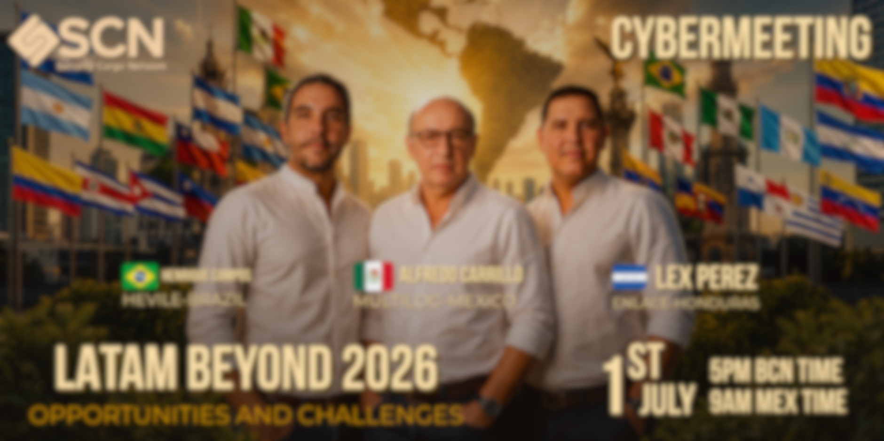
THANK YOU

